Slide 1


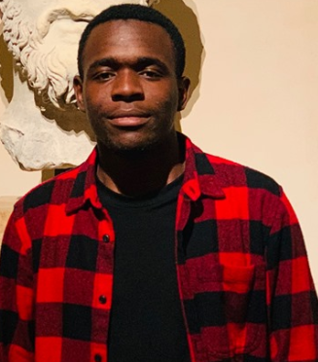

Foosball society Project
Team members and their skills :
MO Yinchuan | AZEDDINE Housna | KOUFERIDJI Oumar | WEI Yi
Python Développer, TensorFlow knowledge, Pytorch – yolov3, ImageAI
Python Développer, TensorFlow knowledge
Python Développer, TensorFlow knowledge
Python Développer, TensorFlow knowledge, Pytorch – yolov3, ImageAI

Slide 2
Foosball society Project
Machine Learning using Videos
Chosen theme :
Project Description :
We decided to work on the Foosball society project recommended to us by Mrs BOUZBOUZ.
The project consists on analysing a foosball match footage and detecting the speed and trajectory of the ball, and also the movements of the mini players on the movable bars.
We will realize our project, using machine Learning algorithms, TensorFlow library, Spark and Hadoop.
Ideally, we will try to predict if there will be a goal or not based on all the information gathered and analysed.

